Slide 1
Identifying Patterns of Employee Performance
2025-09-13 EDA project by
Minsung Kim

Slide 2
Agenda
01 | Project Goal
02 | Exploring the Data
03 | Model Diagnostic
04 | Results and Interpretation
05 | Closing Statement

Slide 3
Project Goal

Slide 4
Patterns of Employee Performance
This project will aim to identify element(s) in Human Resource data influencing employee performance

Slide 5
Defining Employee Performance
Employee performance is defined by four ordinal categories:
Exceeds
Fully Meets
Needs Improvement
PIP (Performance Improvement Plan)

Slide 6
Exploring the Data

Slide 7

About the Data
The dataset contains employee information including:
Performance
Absence
Employee Engagement
Employee Satisfaction
Race
Department
The project uses a simulated Human Resources Data Set by Dr. Richard Huebner from Cambridge College

Slide 8
Employee Satisfaction by Performance

Slide 9
Employee Engagement by Performance
Performance Score and Employee Engagement (i.e. Company Loyalty)
PerformanceScore | Average of EngagementSurvey
Exceeds | 4.48
Fully Meets | 4.24
Needs Improvement | 2.99
PIP | 2.22
Grand Total | 4.11
Notes:
Lower survey score implies lower levels of employee engagement with the organization

Slide 10
Absence per Performance Score
Performance Score and Average of Absence
PerformanceScore | Average of Absences
Exceeds | 10.49
Fully Meets | 10.22
Needs Improvement | 11.33
PIP | 8.31
Grand Total | 10.24
Notes:
Number of absences don’t vary significantly for each performance level.

Slide 11
Performance Score Rate by Race
Performance Score and Race (by Row Total %)
 | PerformanceScore
Race | Exceeds | Fully Meets | Needs Improvement | PIP
American Indian or Alaska Native | 33.33% | 66.67% | 0.00% | 0.00%
Asian | 3.45% | 86.21% | 6.90% | 3.45%
Black or African American | 15.00% | 72.50% | 11.25% | 1.25%
Hispanic | 0.00% | 100.00% | 0.00% | 0.00%
Two or more races | 9.09% | 72.73% | 0.00% | 18.18%
White | 11.76% | 79.68% | 3.74% | 4.81%
Performance Total | 11.90% | 78.14% | 5.79% | 4.18%
Notes:
Percentage of employees needing performance improvement (Needs Improvement, PIP) is not significant across the race category

Slide 12
Performance Score by Department
Performance Score Percentage across Department (by Row Total %)
 | PerformanceScore
Department | Exceeds | Fully Meets | Needs Improvement | PIP
Production | 12.92% | 76.08% | 7.18% | 3.83%
Sales | 6.45% | 77.42% | 3.23% | 12.90%
Software Engineering | 18.18% | 72.73% | 9.09% | 0.00%
IT/IS | 12.00% | 84.00% | 2.00% | 2.00%
Executive Office | 0.00% | 100.00% | 0.00% | 0.00%
Admin Offices | 0.00% | 100.00% | 0.00% | 0.00%
Grand Total | 11.90% | 78.14% | 5.79% | 4.18%
Notes:
Percentage of employees needing performance improvement (Needs Improvement, PIP) is not significant across the departments

Slide 13
Key Takeaways
Employee Satisfaction decreases as Performance decreases
Employee engagement is lower for lower performing employee
Absence, race or department do not affect performance rating

Slide 14
Model Diagnostic

Slide 15
Logistic Regression
Logistic regression models the impact of predictors on a binary outcome
Employee Performance (0 = Optimal performance, 1 = Suboptimal Performance)
Individual effects of Employee Satisfaction, Engagement and Absence on performance were reviewed
$$Y_{Performance}=β_{0}+β_{1}X_{satisfaction}+{β_{2}X}_{engagement}+{β_{3}X}_{absence}$$

Slide 16
Assumptions of Logistic Regression
Before the regression may be applied to the data, the following conditions must be satisfied
Continuous Predictors must be linear with the (log odds of the) outcome variable
There must not be influential outlier(s) in the continuous predictors
No predictors should be too similarly correlated (Multicollinearity)

Slide 17
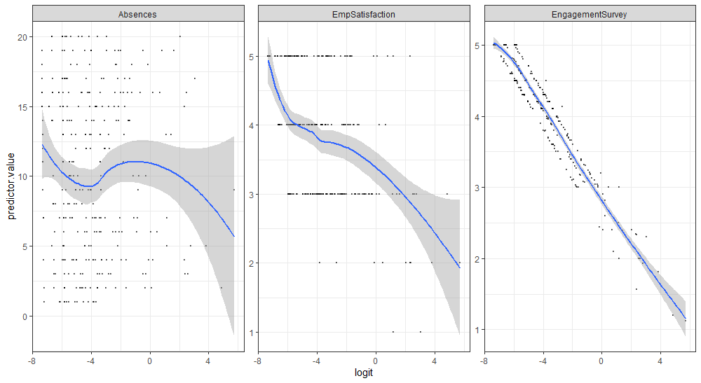
Assumption of Linearity
Notes:
We see an overall decreasing trend (especially so with Employee Satisfaction and Engagement).
It’s important to note that employee satisfaction was treated as a continuous variable despite having ordinal characteristics (i.e., 1 = very dissatisfied, 2 = dissatisfied, 3 = neutral, 4 = satisfied, 5 = very satisfied). This was a deliberate decision made to maintain ascending order level.
Since positive outcome (y=1) is assigned to employee’s odds of scoring poorly on the performance assessment, any increase in logit outcome implies higher odds of poor performance.
The plot results then make intuitive sense as one would expect a performance level to decrease as employee satisfaction and engagement levels drop.
The plot of absence is much less linear thus suggesting weaker association.
This outcome matches the statistical insignificance absence has on the overall performance score (p-value of 0.8716).

Slide 18
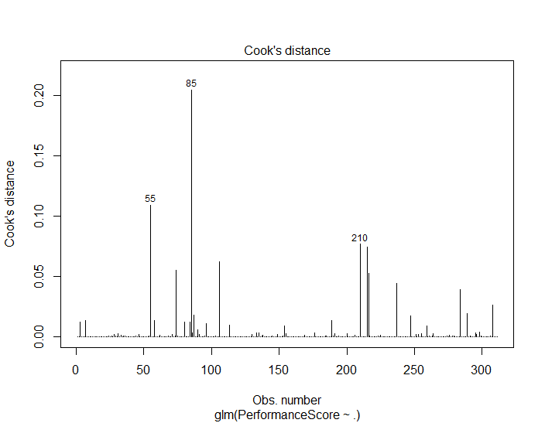





Assumption of Influential Outlier(s)
The left plot highlights the top 3 outliers.

Slide 19
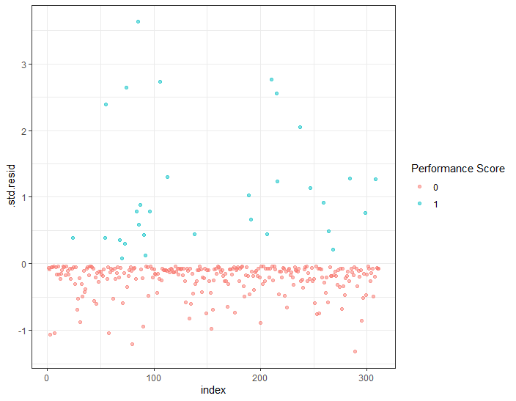
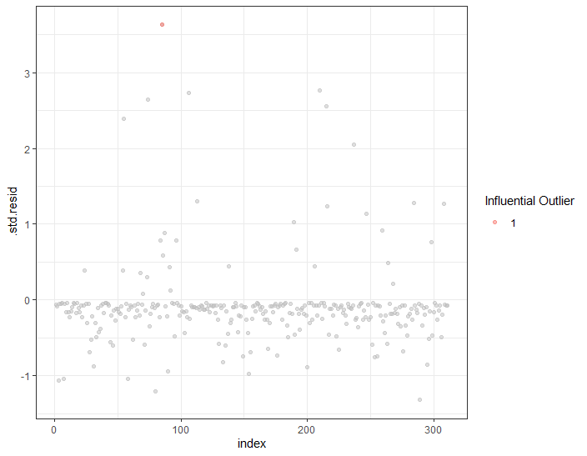

Not all outliers are considered influential. Therefore, separate residual plots were used to highlight the influential outlier
Notes:
Above results highlight the top value as an influential outlier. The problematic outlier was removed from the data to satisfy the assumption.

Slide 20
Assumption of Multicollinearity
Multicollinearity was assessed by comparing the VIF (Variance Inflation Factor) of each predictors involved.
In general, VIF values above 5 imply high collinearity
EngagementSurvey EmpSatisfaction Absences
1.011898 1.040472 1.043579

Slide 21
Results and Interpretation

Slide 22
Effects of Predictors Explained
Probability of an employee with no satisfaction, no engagement and no absence receives poor performance is 99.96%.
Unit increase in employee satisfaction was 0.47 times more likely to perform poorly.
Unit increase in employee engagement was 0.04 times more likely to perform poorly.
Unit increase in absence was 0.99 times more likely to perform poorly.
This simply means increase in employee engagement strongly enhance performance, followed by employee satisfaction
Absence have virtually no impact on employee performance
Notes:
Both employee satisfaction and engagement were considered statistically significant (p-values < 0.05) while absence was considered statistically insignificant.
Another model was fitted including secondary predictors (race, department), but race and departments were not considered statistically significant predictors of performance score (p-values > 0.05).

Slide 23
Model Accuracy and Reliability
Model Outcome
 | Optimal Performance | Suboptimal Performance | Total
Optimal Performance | 278 | 2 | 280
Suboptimal Performance | 8 | 22 | 30
Total | 286 | 24 | 310
Actual Outcome
96.8% overall accuracy, 91.7% precision, 73.3% sensitivity/recall
Notes:
At 0.5 cutoff (as default), 99.29% of true negative and 73.33% of true positives were identified.
A cutoff (or threshold) is a value that decides where the outcome is classified as either optimal performance (y = 0) or suboptimal performance (y = 1).
Threshold of 0.5 would mean any probabilities of the outcome variable over 0.5 would be classified as suboptimal and vice versa.
The model recorded 96.8% overall accuracy (TP + TN / Total), 91.7% precision (percentage of correctly identified TP by the model), and 73.3% sensitivity/recall (percentage of correctly identified positive outcome by the model compared to the actual count of positive outcomes – i.e. TP).

Slide 24
Finding the Optimal Threshold
Notes:
Prediction matrices at different threshold levels were used to identify the optimal threshold.
Threshold of 0.4 was identified as the best threshold with 96.5% accuracy, 82.8% precision, and 80.0% sensitivity.
Based on the plot above, accuracy reaches its maximum at threshold 0.2 where it is maintained across rest of the cutoff threshold.
Precision is also seen to increase as threshold increases but plateaus at around 0.6.
Recall or sensitivity starts as 100% (meaning all datapoints are considered positives) and maintains a slight decrease between 0.1 to 0.4 after which the TP rate decreases significantly.
0.4 was identified as the optimal threshold since it maintains sufficiently high accuracy and precision without losing its TP rate significantly.
Threshold after 0.4 sees significant decrease in the TP/sensitivity meaning more positive outcomes may be inaccurately categorized as negatives (false negative).
The ROC curve to the right reaffirms 0.4 threshold provides the best balance of proportions of correctly classified employees (80%) with least amount of incorrectly classified employee (1.8%).

Slide 25

Verifying the Threshold
Notes:
ROC curve provides a visual summary of all confusion matrices created at each cutoff/threshold. By comparing the true positive rate (proportion of employees correctly categorized as poorly performing) with the false positive rate (proportion of employees falsely categorized as poorly performing), ROC curve shows which threshold provides the most appropriate balance between TP/FP rate.
The ROC curve shows how TP rate plateaus around the 80% mark and each increase of TP rate from this point onward leads to significant increase of FP rate.
This plot reaffirms that 0.4 threshold provides the best balance of proportions of correctly classified employees (80%) with least amount of incorrectly classified employee (1.8%).

Slide 26
Closing Statement

Slide 27
Key Takeaway
From this basic analysis, we have determined the following:
Employee engagement is the strongest predictor of performance, followed by employee satisfaction.
Cut-off of 0.4 provides ensures best balance between correctly classified performance scores with minimal false negatives

Slide 28
Future Direction
Test the model using training and testing data
Implement a model to forecast performance for future employees

